Slide 1

Machine Learning Algorithms (k-Nearest Neighbors(k-NN))
Md. Abu Naser Mojumder

Slide 2
Well known Machine Learning Algorithms
Supervised Learning
Unsupervised Learning
Reinforcement Learning
Regression
Simple Linear Regression
Multiple Linear Regression
Polynomial Regression
Clustering
K-Means Clustering
Hierarchical Clustering
Upper Confidence Bound(UCB)
Thomson Sampling
Classification
Logistic Regression
k-Nearest Neighbors(k-NN)
Support Vector Machine(SVM)
Naïve Bayes
Decision Tree Classification
Random Forest Classification
Dimensionality Reduction
Principal Component Analysis(PCA)
Linear Discriminant Analysis (LDA)
Deep Learning Algorithm
Artificial Neural Network(ANN)
Convolutional Neural Network(CNN)

Slide 3
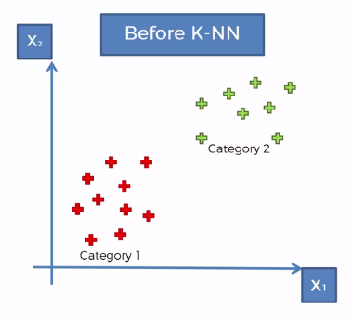
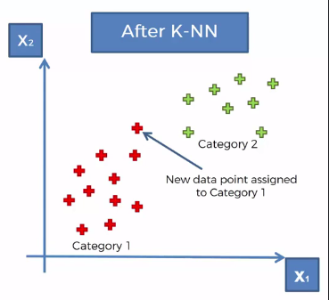
k- Nearest Neighbors
K-Nearest Neighbors is one of the most basic yet essential classification algorithms in Machine Learning. It belongs to the supervised learning domain and finds intense application in pattern recognition, data mining and intrusion detection.
Let we have a scenario where we have two categories of data.
Category 1 (Red)
Category 2 (Green)
We have two variables(Classes) X1 and X2, and
A new datapoint will be classified according to these two classes.
Now we add a new datapoint in dataset.
The question is, should it fall into the red category or green category? How do we decide that? How do we classify that new datapoint as a red or green datapoint?
And this point the k-NN algorithm will come to assist us.
At the end of performing this algorithm we'll be able to identify whether it's a red or green point,
And in this case the point turned out to be red.

Slide 4
k- Nearest Neighbors Algorithm
How its work?
Step 1: Choose the number K of neighbors
Step 2: Take the K nearest neighbors of the new datapoint, according to the Euclidean distance.
Step 3: Among these K neighbors, count the number of data points in each category.
Step 4: Assign the new data point to the category where you counted the most neighbors.
Your Model is Ready!

Slide 5
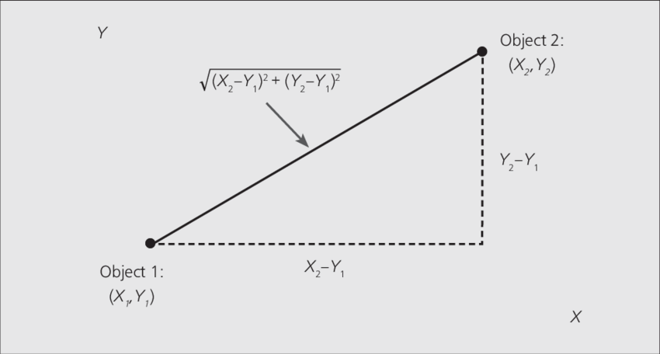
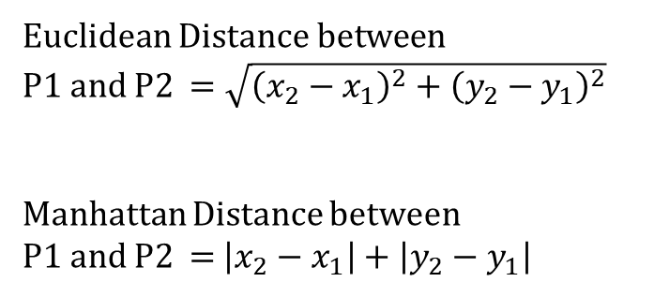
k- Nearest Neighbors
Euclidean Distance vs Manhattan Distance
Euclidean Distance between
P1 and P2 $=\sqrt{{\left(x_{2}−x_{1}\right)}^{2}+{\left(y_{2}−y_{1}\right)}^{2}}$
Manhattan Distance between
P1 and P2 = $\left|x_{2}−x_{1}\right|+\left|y_{2}−y_{1}\right|$

Slide 6
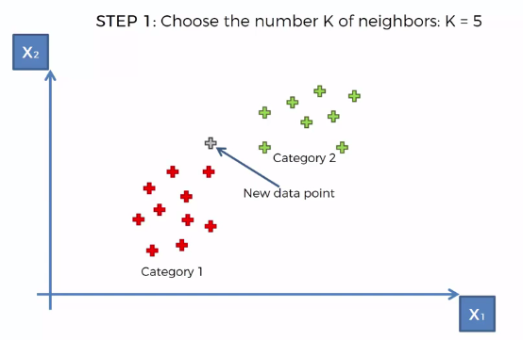
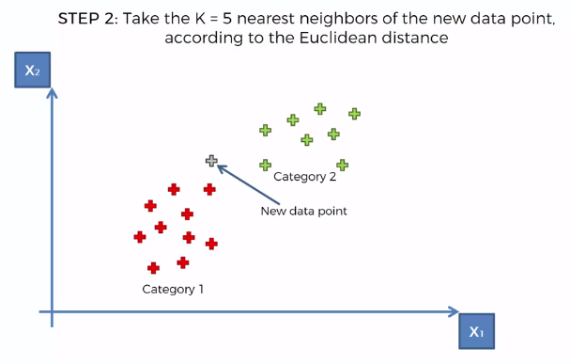
k- Nearest Neighbors
An example:

Slide 7
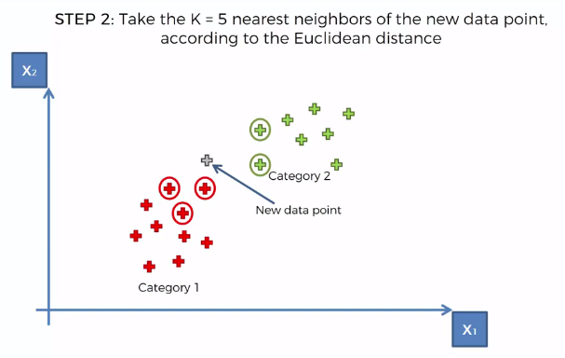
k- Nearest Neighbors

Slide 8
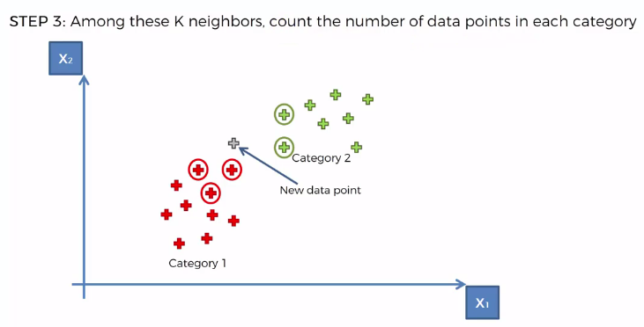
k- Nearest Neighbors
Category 1: 3 Neighbors
Category 2: 2 Neighbors
Therefore, The new point belongs to the Red Category.

